Slide 1



Basal Ganglia
Dr. Massara Ghassan Abulkareem
Physiology Department
College of Medicine\ University of Basrah

Slide 2
Objectives
1. What is basal ganglia?
2. Neural circuitry of basal ganglia
putamen circuit.
caudate circuit.
3. Functions.
4. Basal Ganglia neurotransmitter.
5. Clinical abnormalities.
University of Basrah-College of Medicine-Physiology Department
1

Slide 3
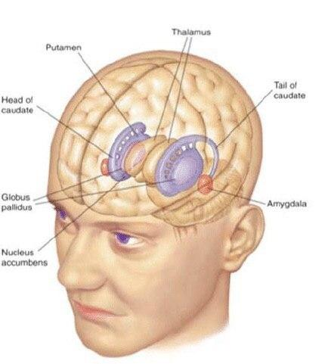
Basal Ganglia
University of Basrah-College of Medicine-Physiology Department
2
Notes:
subcortical multinucleated structure, located deeply occupying a large portion of the interior regions of both cerebral hemispheres
It is considered as an accessory motor system that functions usually not by itself but in close association with the cerebral cortex and corticospinal motor control system.
the basal ganglia receive most of their input signals from the cerebral cortex and also return almost all their output signals back to the cortex.

Slide 4
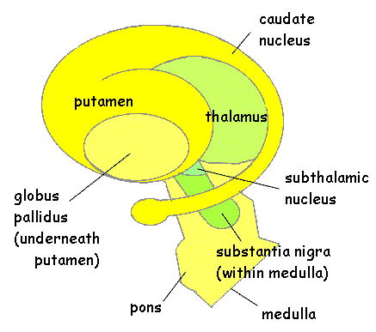
Basal Ganglia
University of Basrah-College of Medicine-Physiology Department
3
Notes:
Basal ganglia consist of 5 nuclie
caudate nucleus
putamen
globus pallidus
substantia nigra
and subthalamic nucleus

Slide 5
subcortical multinucleated structure, located deeply occupying a large portion of the interior regions of both cerebral hemispheres
It is considered as an accessory motor system that functions usually not by itself but in close association with the cerebral cortex and corticospinal motor control system.
the basal ganglia receive most of their input signals from the cerebral cortex and also return almost all their output signals back to the cortex.
University of Basrah-College of Medicine-Physiology Department
4

Slide 6
NEURONAL CIRCUITRY
OF THE BASAL GANGLIA
The anatomical connections between the basal ganglia and the other brain elements that provide motor control are complex,
2 anatomical connections within BG
One with motor cortex, thalamus, and associated brain stem and cerebellar circuitry.
And the second is the major circuitry of the basal ganglia system, showing the tremendous interconnections among the basal ganglia plus extensive input and output pathways between the other motor regions of the brain and the basal ganglia
University of Basrah-College of Medicine-Physiology Department
5

Slide 7
Two major circuits:
putamen circuit
caudate circuit
University of Basrah-College of Medicine-Physiology Department
6

Slide 8
Neural Pathways of the Putamen Circuit
premotor and supplementary areas of the motor cortex and in the
somatosensory areas of the sensory cortex.
Putamen
nucleus
Internal
portion of the globus pallidus,
ventroanterior and ventrolateral relay nuclei of the thalamus
cerebral primary motor cortex to portions of the premotor and supplementary cerebral areas
7
University of Basrah-College of Medicine-Physiology Department

Slide 9
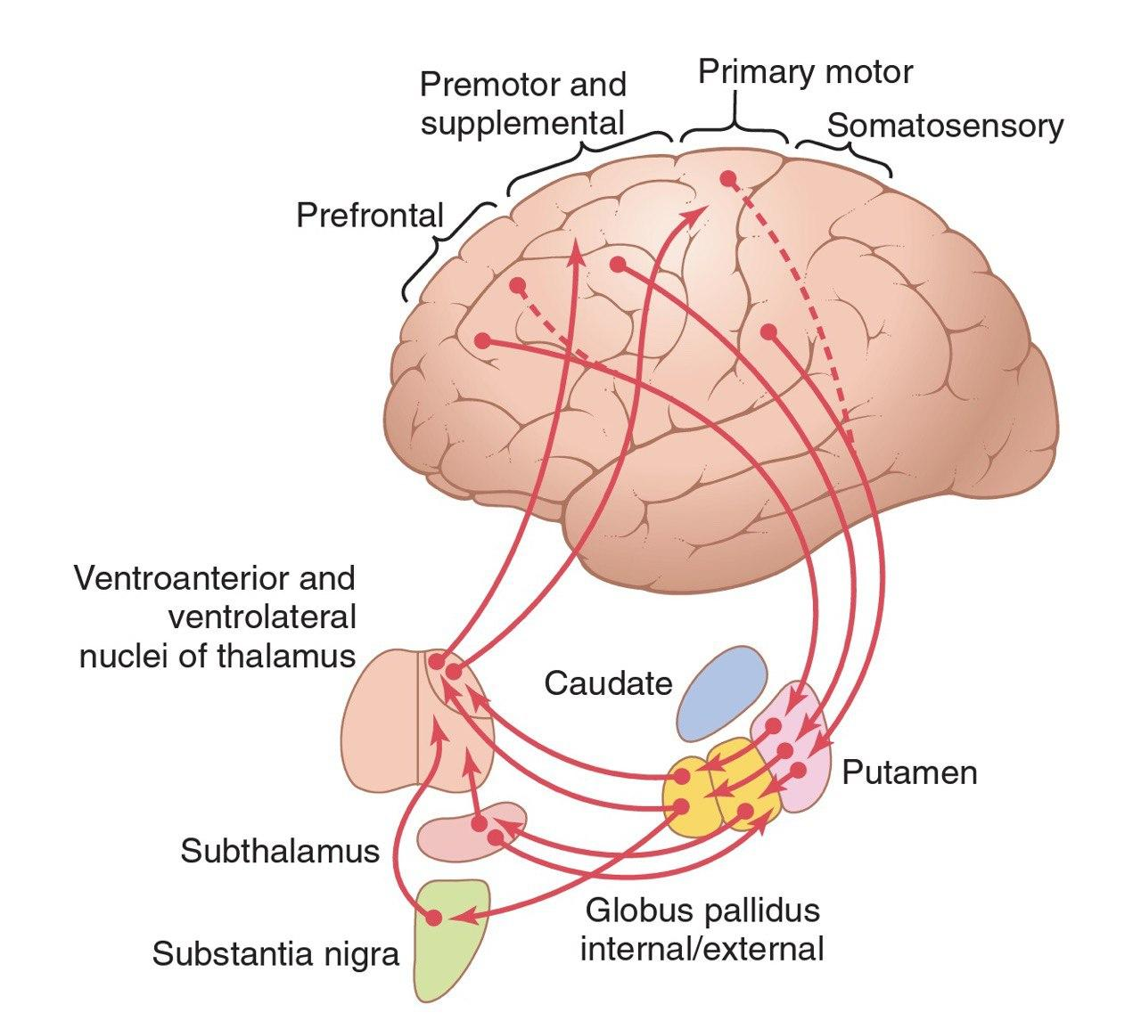
Putamen circuit
University of Basrah-College of Medicine-Physiology Department
8

Slide 10
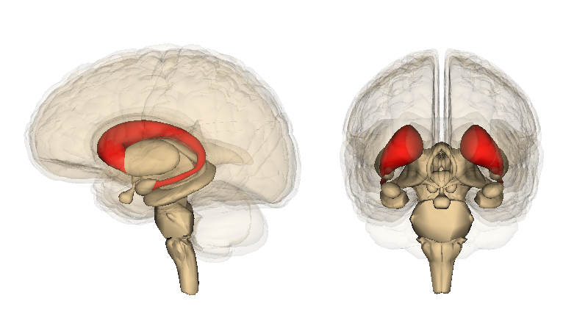
Caudate Nucleus
University of Basrah-College of Medicine-Physiology Department
9
Notes:
caudate nucleus, extends into all lobes of the cerebrum, beginning anteriorly in the frontal lobes, then passing posteriorly through the parietal and occipital lobes, and finally curving forward again like the letter “C” into the temporal lobes.
Furthermore, the caudate nucleus receives large amounts of its input from the association areas of the cerebral cortex overlying the caudate nucleus, mainly areas that also integrate the different types of sensory and motor information into usable thought patterns.

Slide 11
Caudate circuit
from the cerebral cortex
caudate nucleus
Internal
globus pallidus,
relay nuclei of the ventroanterior and ventrolateral thalamus
prefrontal, premotor, and supplementary
motor areas of the cerebral cortex,
University of Basrah-College of Medicine-Physiology Department

Slide 12
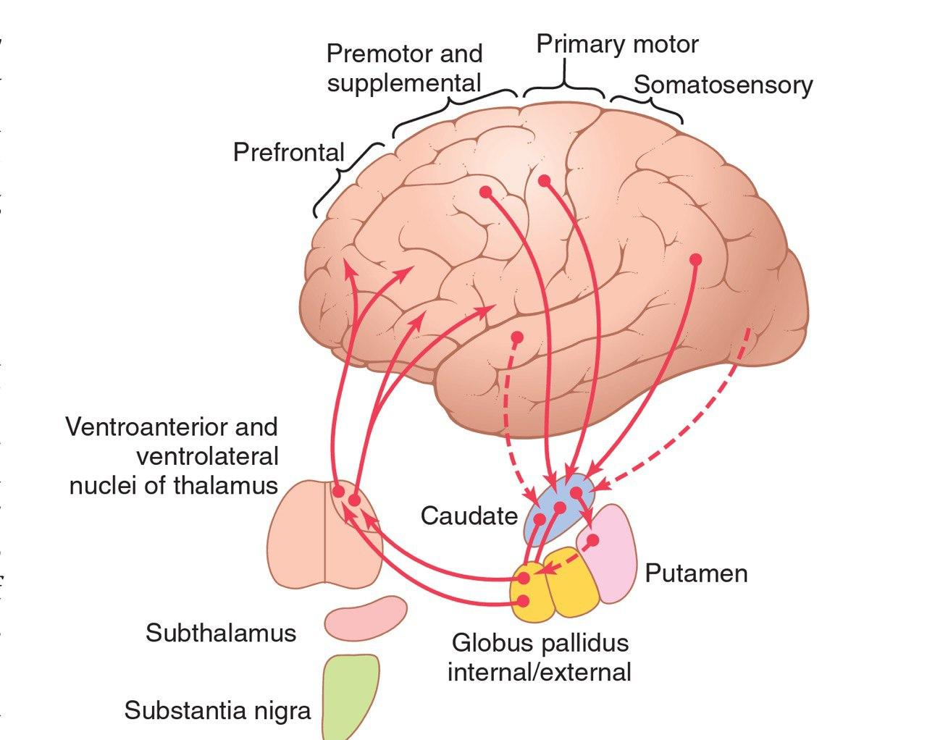
Caudate Circuit
University of Basrah-College of Medicine-Physiology Department
11

Slide 13
The caudate nucleus plays a major role in the cognitive control of motor activity.
The term cognition means the thinking processes of the brain, using both sensory input to the brain plus information already stored in memory.
Most of our motor actions occur as a consequence of thoughts generated in the mind, a process called cognitive control of motor activity.
University of Basrah-College of Medicine-Physiology Department
12

Slide 14
Basal Ganglia (Change Timing and Scale Intensity of Movements)
Brain is capable to control movement by:
Determine how rapidly movement is to be performed
Control how large movement will be.
    Example: a person may write letter "a" slowly or rapidly. Also, may write a small "a" on a piece of paper or a large "a" on a chalkboard. Regardless of choice, proportional characteristics of letter remain nearly same.
University of Basrah-College of Medicine-Physiology Department
13

Slide 15
An example is the writing of letters of the alphabet. When the basal ganglia sustain serious damage, the cortical system of motor control can no longer provide these patterns. Instead, one’s writing becomes crude, as if one were learning how to write for the first time.
Other patterns that require the basal ganglia are cutting paper with scissors, hammering nails, shooting a basketball through a hoop, passing a football, throwing a baseball.
University of Basrah-College of Medicine-Physiology Department
14

Slide 16
Basal Ganglia neurotransmitter
Dopamine pathway from substantia nigra to caudate nucleus & putamen (inhibitory).
GABA pathway from caudate nucleus and putamen to globus pallidus and substantia nigra (inhibitory).
ACh pathway from cortex to caudate nucleus and putamen.
University of Basrah-College of Medicine-Physiology Department
15

Slide 17
Multiple general pathways from brainstem (secrete norepinephrine, serotonin, enkephalin and several other neurotransmitters).
Multiple glutamate pathways provide most of excitatory signals.
University of Basrah-College of Medicine-Physiology Department
16

Slide 18
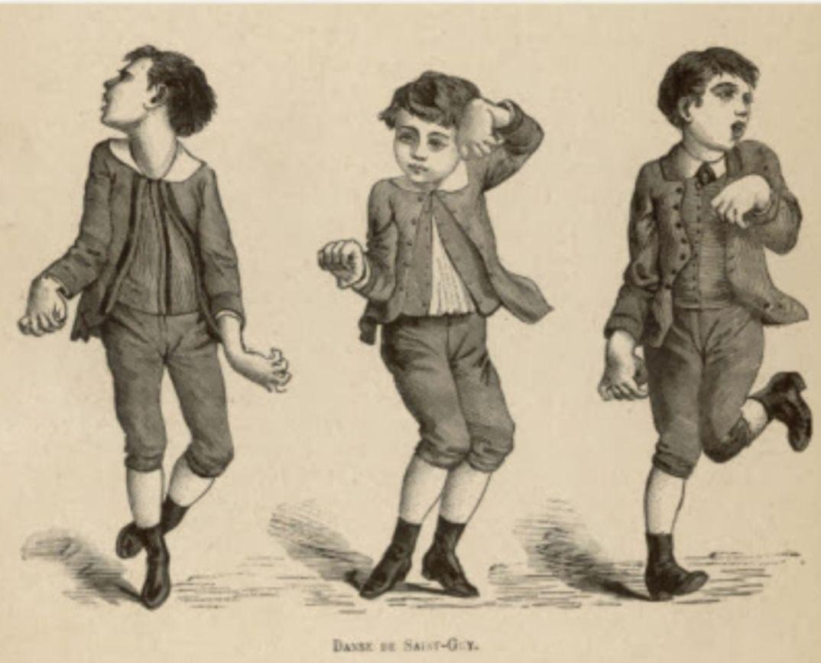

Clinical abnormalities
Chorea is an abnormal involuntary movement derived from the Greek word “dance”. It is characterized by brief, abrupt, irregular, unpredictable, non-stereotyped movements.
Due to lesion in caudate nucleus
University of Basrah-College of Medicine-Physiology Department
17

Slide 19

Athetosis: slow, involuntary, convoluted, writhing movements of the fingers, hands, toes, and feet and in some cases, arms, legs, neck and tongue.
Due to lesion in Globus pallidus
University of Basrah-College of Medicine-Physiology Department
18

Slide 20
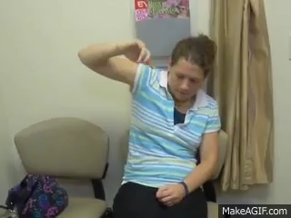
Hemiballismus it is flailing, ballistic, undesired movements of the limbs.
lesion in subthalamic nucleus
University of Basrah-College of Medicine-Physiology Department
19

Slide 21

Lesion in substantia nigra
Parkinson’s disease, which is also known as paralysis agitans, results from destruction of the portion of the substantia nigra that sends dopamine-secreting nerve fibers to the caudate nucleus and putamen. The disease is characterized by
(1) rigidity of much of the musculature of the body.
University of Basrah-College of Medicine-Physiology Department
20

Slide 22

(2) involuntary tremor
University of Basrah-College of Medicine-Physiology Department
21

Slide 23

(3) difficulty in initiating movement, called Hypokinesia or Akinesia.
University of Basrah-College of Medicine-Physiology Department
22

Slide 24
Recap
1. subcortical multinucleated structure, located deeply occupying a large portion of the interior regions of both cerebral hemispheres
2. the basal ganglia receive most of their input signals from the cerebral cortex and also return almost all their output signals back to the cortex.
putamen circuit
caudate circuit
3. Its act by Change Timing and Scale Intensity of Movements
4. Multiple types of neurotransmitter (excitatory, inhibitory
5. Clinical abnormalities.
25

Slide 25
Thank You

